Slide 1
Greenhouse Gas Emissions for Refrigerant Choices in Room Air Conditioner Units
Michael Galka and Dr. Paul Blowers
The University of Arizona
NASA Space Grant Internship Program
Fall 2011-Spring 2012

Slide 2
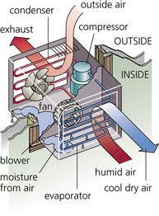
Introduction-Room Air Conditioners
Air conditioner
Compressor
Condenser
Evaporator
Expansion Valve
2 fans
2 tons (24,000 Btu) cooling

Slide 3
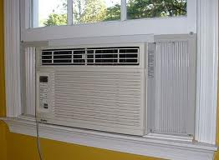
RACs in the U.S.
AC ownership information from EIA in 2009
25.9 million homes with at least 1 RAC unit
Total comes to 23% of all U.S. households have at least one RAC
RAC ownership and use is likely to increase as the standards of living rise worldwide
Notes:
Reasons for likely increase in use of RACs is low cost of production and easy transport. Also have lower values of electricity consumption than central air conditioning which favor areas where strong electrical grids are not established.

Slide 4
History of Refrigerants
Some of the first refrigerants included
Ammonia (toxic)
HCs such as propane (flammable)
CFCs synthesized in 1930s
Replaced use of HCs
R-12 (ODP=1, GWP=10900)
Montreal Protocol banned production (1987)
HCFCs synthesized in 1980s
Replacing CFCs
R-22 (ODP=0.06, GWP=1810)
Montreal Protocol banned production (1992)

Slide 5
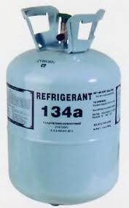
Today’s Refrigerant
HFCs synthesized as replacement for HCFCs
R-134a
Commonly used in air conditioners
ODP=0, GWP=1600
Emissions continually increasing since 1990
Little regulation by Clean Air Act

Slide 6
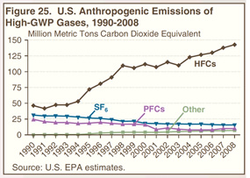

Slide 7
Possible Refrigerant of the Future
Hydrofluoroethers (HFE)
Not regulated due to low GWP and atmospheric lifetime
Increased patents issued for various applications in recent years
Similar properties to current refrigerants in refrigeration
If HFCs fall subject to regulation HFEs could be next in line to replace them

Slide 8
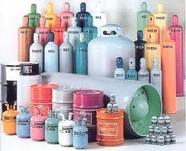
Some Refrigerants Tested
Ammonia (NH₃)
Propane (C₃H₈)
Dimethyl Ether (CH₃OCH₃)
R-22 (CHClF₂ )
R-134a (C₂H₂F₄)
HFE-152a (CF₂ HOCH₃)
HFE-143m (CF₃OCH₃)
Total of 18 refrigerants examined in the study.

Slide 9
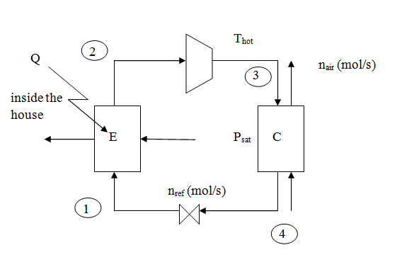
Vapor Compression Refrigeration Cycle

Slide 10

Calculating Results
Model in Excel
Visual basic programming
First and Second Laws of Thermodynamics
Energy and Heat Balances
Sensitivity Analysis

Slide 11
Resulting Numbers of Emissions
R-22 (Standard)
1,160 kg CO₂-equivalent / year per unit
30.03 metric tons CO₂-equivalent / year in U.S.
HFE-143m
1,260 kg CO₂-equivalent / year per unit
32.62 metric tons CO₂-equivalent / year in U.S.
NH₃ (Ammonia)
1,070 kg CO₂-equivalent / year per unit
27.72 metric tons CO₂-equivalent / year in U.S.

Slide 12
Trends and Sensitivity Analysis
Emissions increase as ambient temperature increases.
Emissions increase at thermostat temperature settings decrease.
As refrigerant emissions during disposal of equipment increase R-22, R-134a, and HFE-143m are undesirable.
Improving compressor and line transmission efficiencies decrease emissions using all refrigerants.

Slide 13
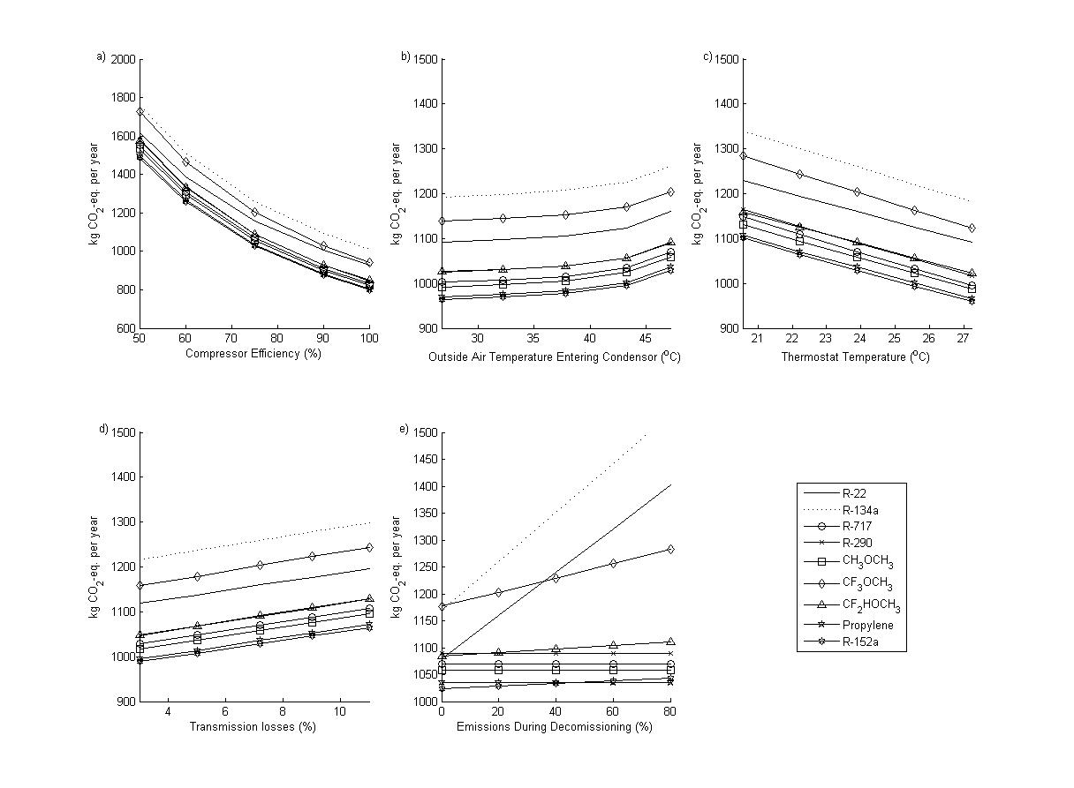
Sensitivity analysis

Slide 14
Conclusion of Study
Dimethyl ether, ammonia, propane, R-152a, and HFE-152a produce lower emissions than currently used refrigerants R-22 and R-134a.
HFE-143m produces nearly identical emissions as R-22
More emissions stem from warmer climates and lower thermostat settings.
Notes:
-Although flammable and/or toxic dimethyl ether, ammonia, and propane should be considered as legitimate substitutes for currently used HFCs due to the very small leakage rates of RAC units.

Slide 15
Additional Considerations
Others to be considered are:
New refrigerants being created in industry
Policies regarding air conditioning settings in southwest U.S.
Other more sustainable energy sources to meet high electricity needs of U.S.
Environmental impact of recovery and reclamation processes for refrigerants

Slide 16


Acknowledgments
NASA Space Grant Internship Program
Paul Blowers, PhD

Slide 17
Questions???
Michael Galka
mgalka@email.arizona.edu

